Slide 1
Penguins
By: Abigail Higgins

Slide 2
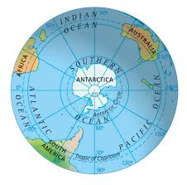
Where do they live?
Penguins live on the Galapagos Islands and in Australia, New Zealand, Africa, South America, and the islands that surround Antarctica.

Slide 3
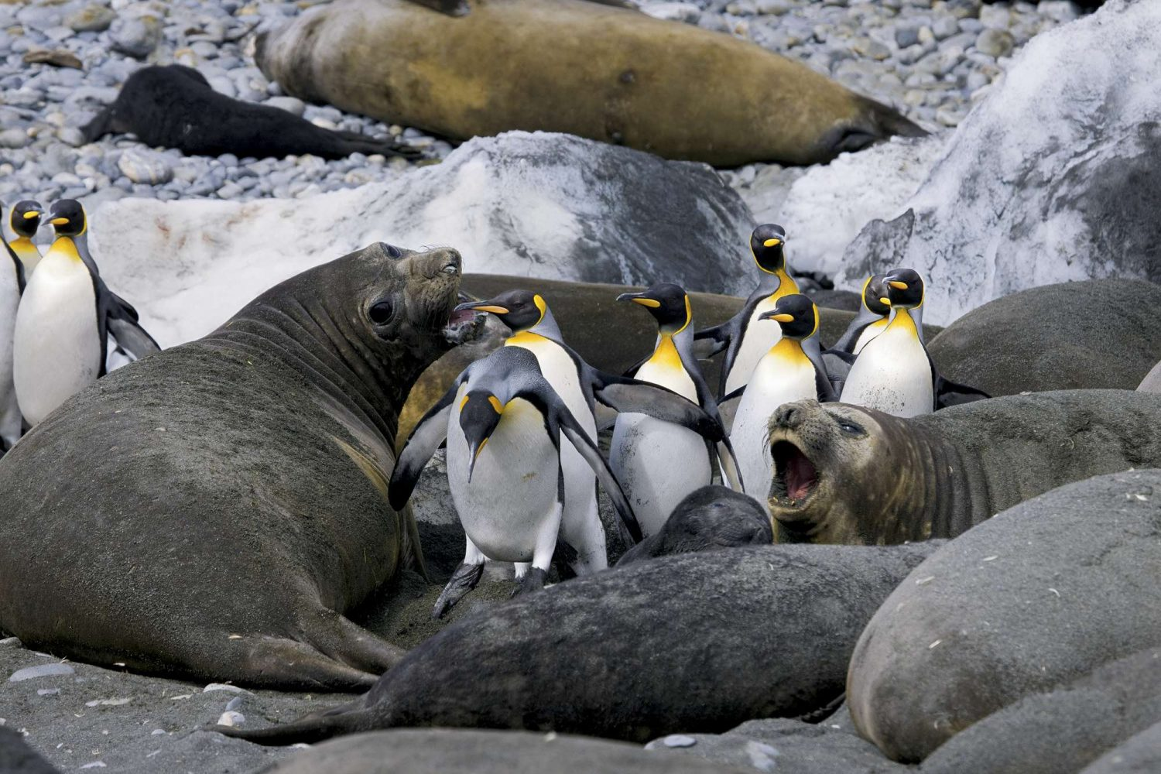
Why are they black?
Predators swimming on the ocean surface see black when they look down into the dark water. Penguin’s dark backs help them blend in with that black color.

Slide 4
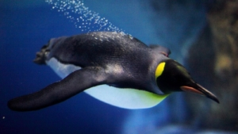
Wings?
Their wings, which are usually called flippers, are made for swimming. Penguin’s flippers are very hard and strong.

Slide 5
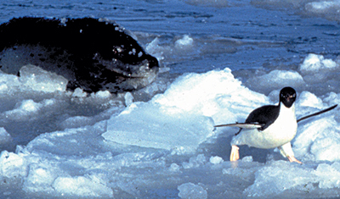
Predators?
Penguins have plenty of predators to watch out for. Sea lions, leopard seals, and orca whales all hunt and eat adult penguins.

Slide 6
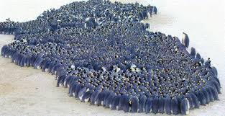
How do penguins stay warm?
Male emperor penguins huddle to help conserve heat. The blubber provides energy for the penguins when they cannot eat. It also helps keep the penguins warm. The down traps air close to the penguin, keeping the penguin warm.

Slide 7
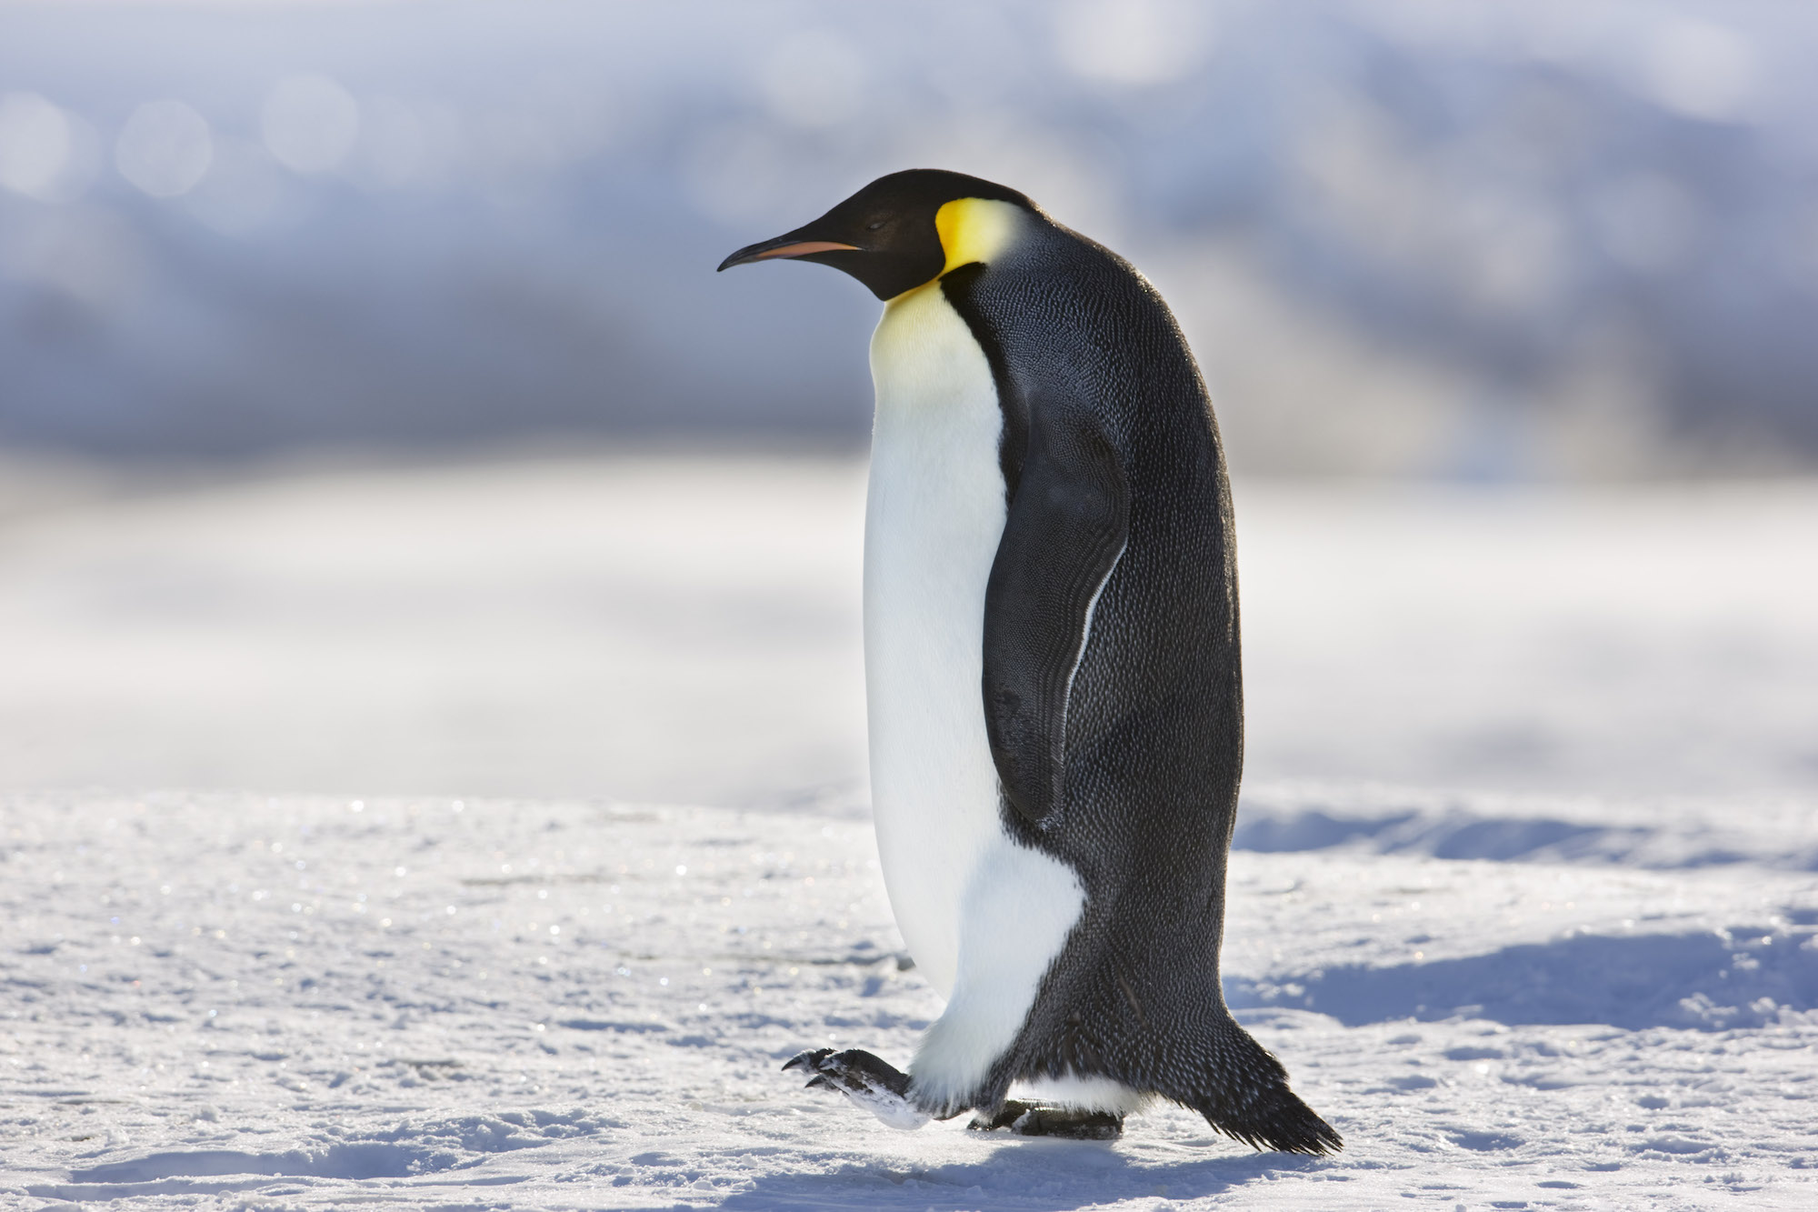
Emperor penguin
Emperor penguins stand about three feet tall, making them the largest penguins. They have yellow and orange ear patches. Emperor penguins live in Antarctica during the winter.

Slide 8
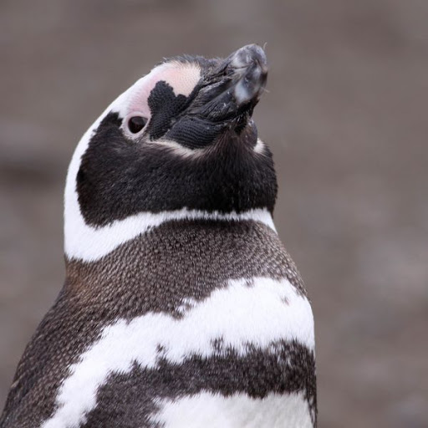
Magellanic Penguins
Magellanic Penguins live on the southern tip of South America and the islands around Antarctica. They build nests in small burrows and under bushes. Magellanic Penguins feed mostly on squid, anchovies, and sardines.

Slide 9
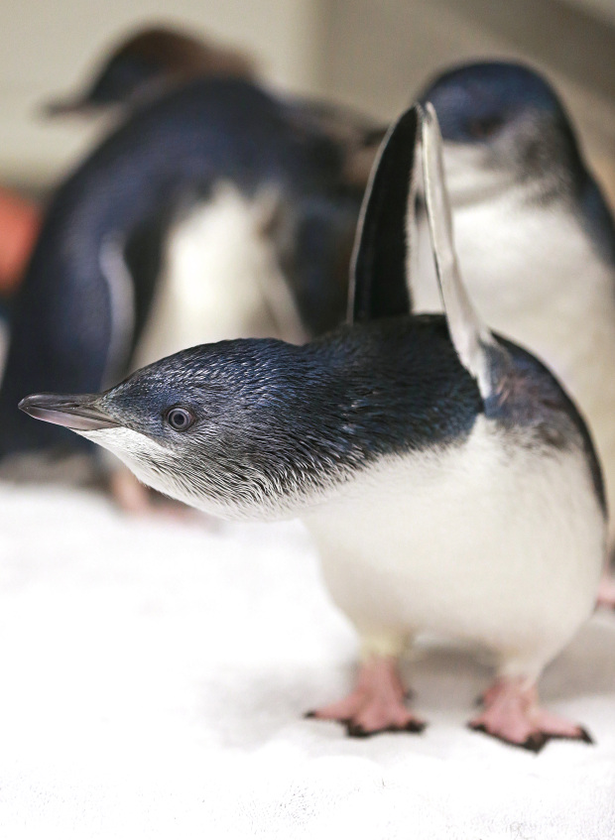
Little Blue penguins
The smallest penguin in the world is the little blue penguin. It is also known as the fairy penguin, the little penguin, or the blue penguin. The little blue penguin is only a foot tall.

Slide 10
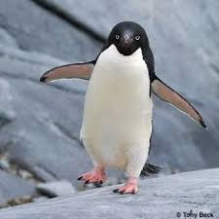
Adelie penguins
Adelie penguins grow to about two feet in height. Like emperor penguins, Adelie penguins lay their eggs and raise their young in Antarctica. However, they do not live in Antarctica year-round.

Slide 11
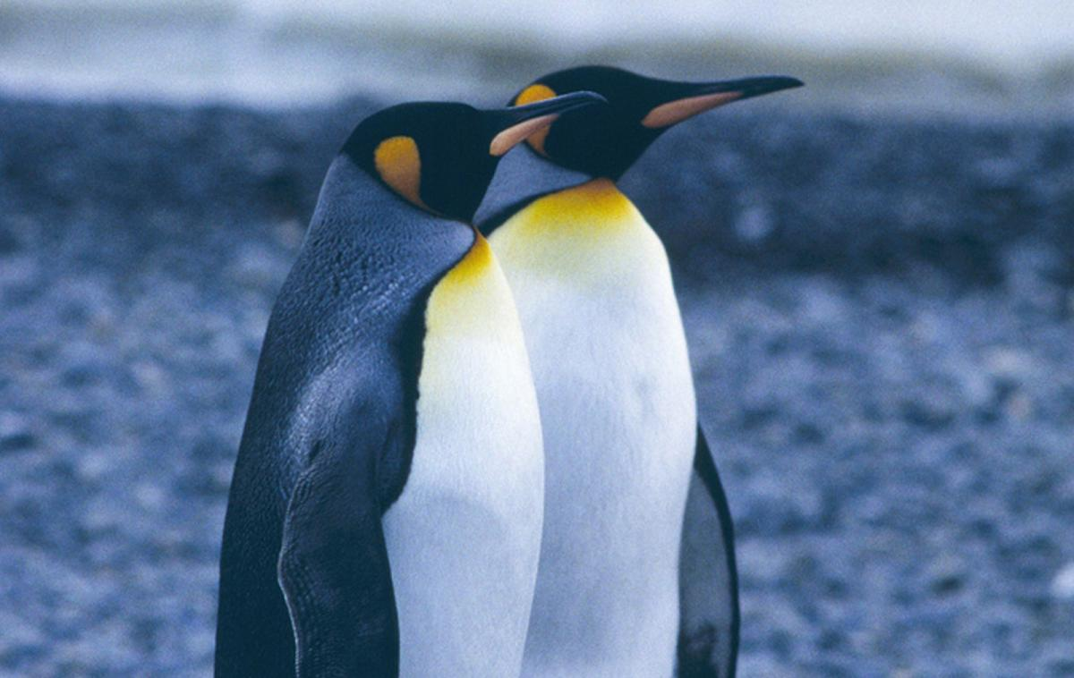
King penguins
The king penguin is the second largest penguin. It has patches of orange feathers near it’s ears. King penguins raise their young during the summer on the islands surrounding Antarctica.

Slide 12
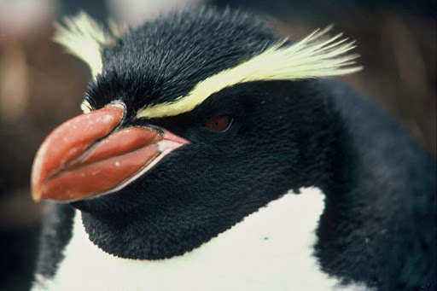
Crested penguins
Crested penguins live on the islands south of South America, Africa, Australia, and New Zealand. Crested penguins vary in size from one to two feet tall. All Crested penguins have similar nesting habits. The female crested penguin lays two eggs.

