Slide 1
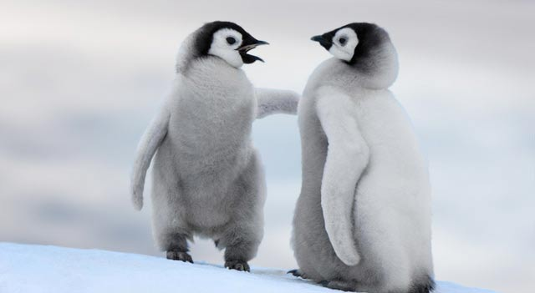
Penguins
By Jazmyne Griffin

Slide 2
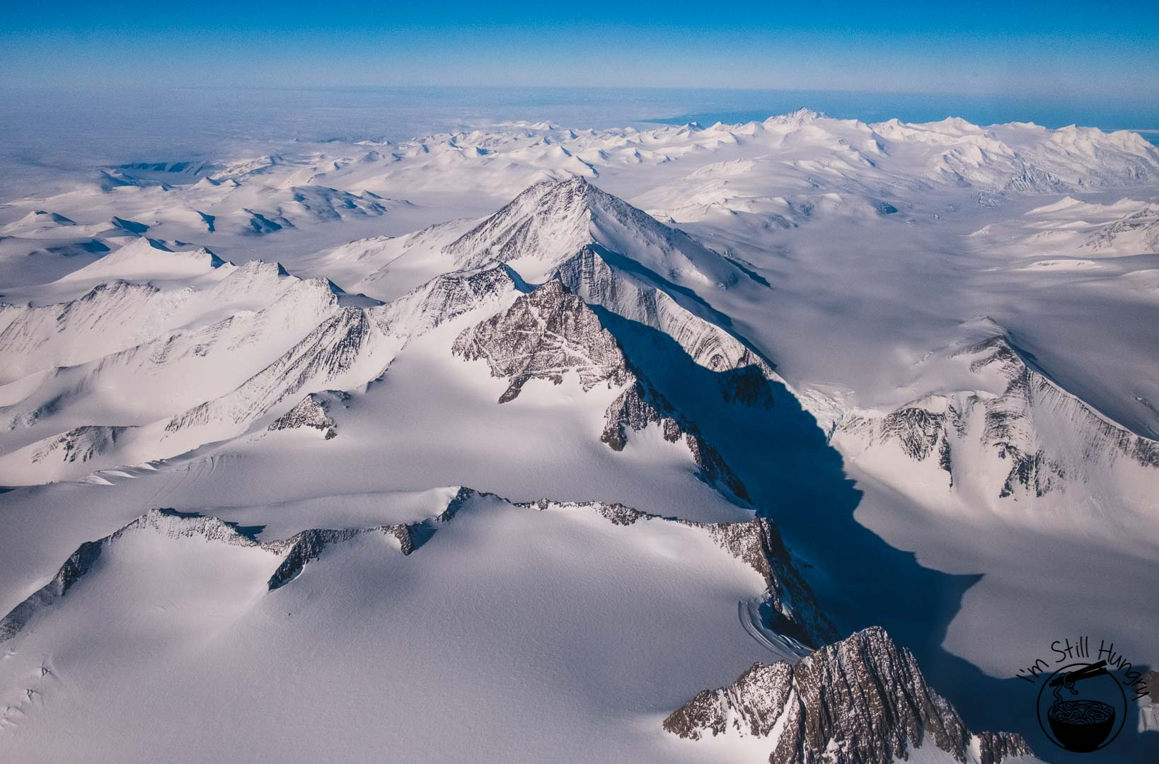
Where do They Live?
Most penguins live in the Galapagos Islands and in Australia, New Zealand, Africa, South America, and the islands that surround Antarctica. They also live on Antarctica itself.
Where do They Live

Slide 3
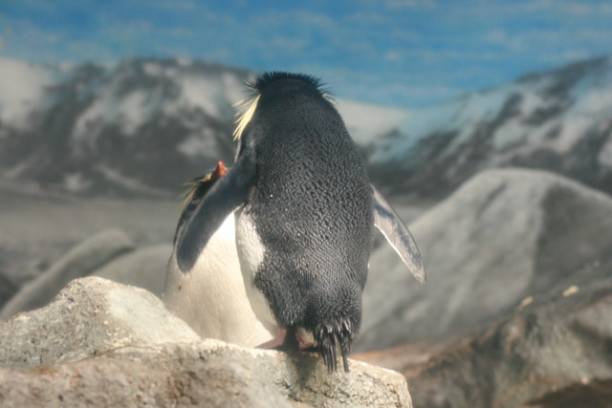


Why are They Black?
The reason why penguins have black on there back is because when predators on the ocean surface look down, the black blends in with the dark dirt so the predators do not see the penguin.
$$11÷0=$$

Slide 4
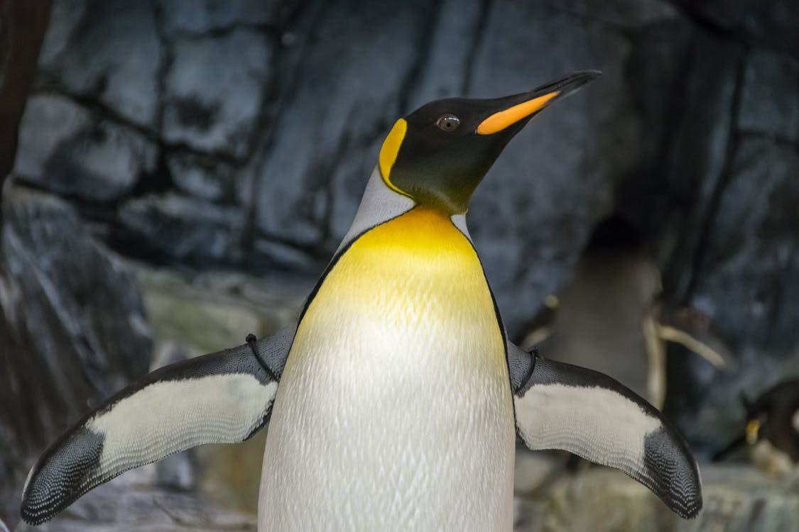
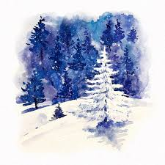
Wings?
Penguins wings are hard and can not bend. That is the main reason why they can not fly. There wing is made for swimming . There wing is mostly called a flipper.

Slide 5
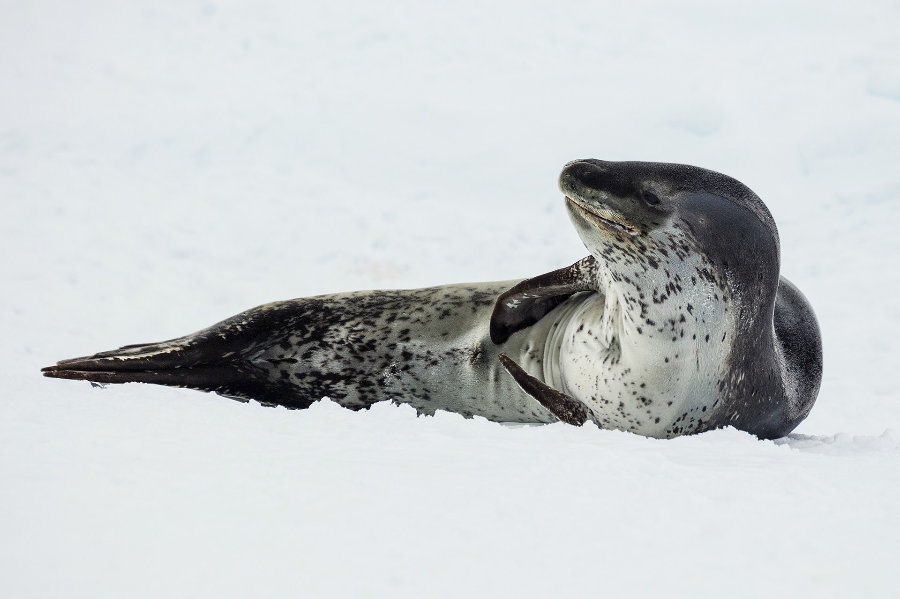
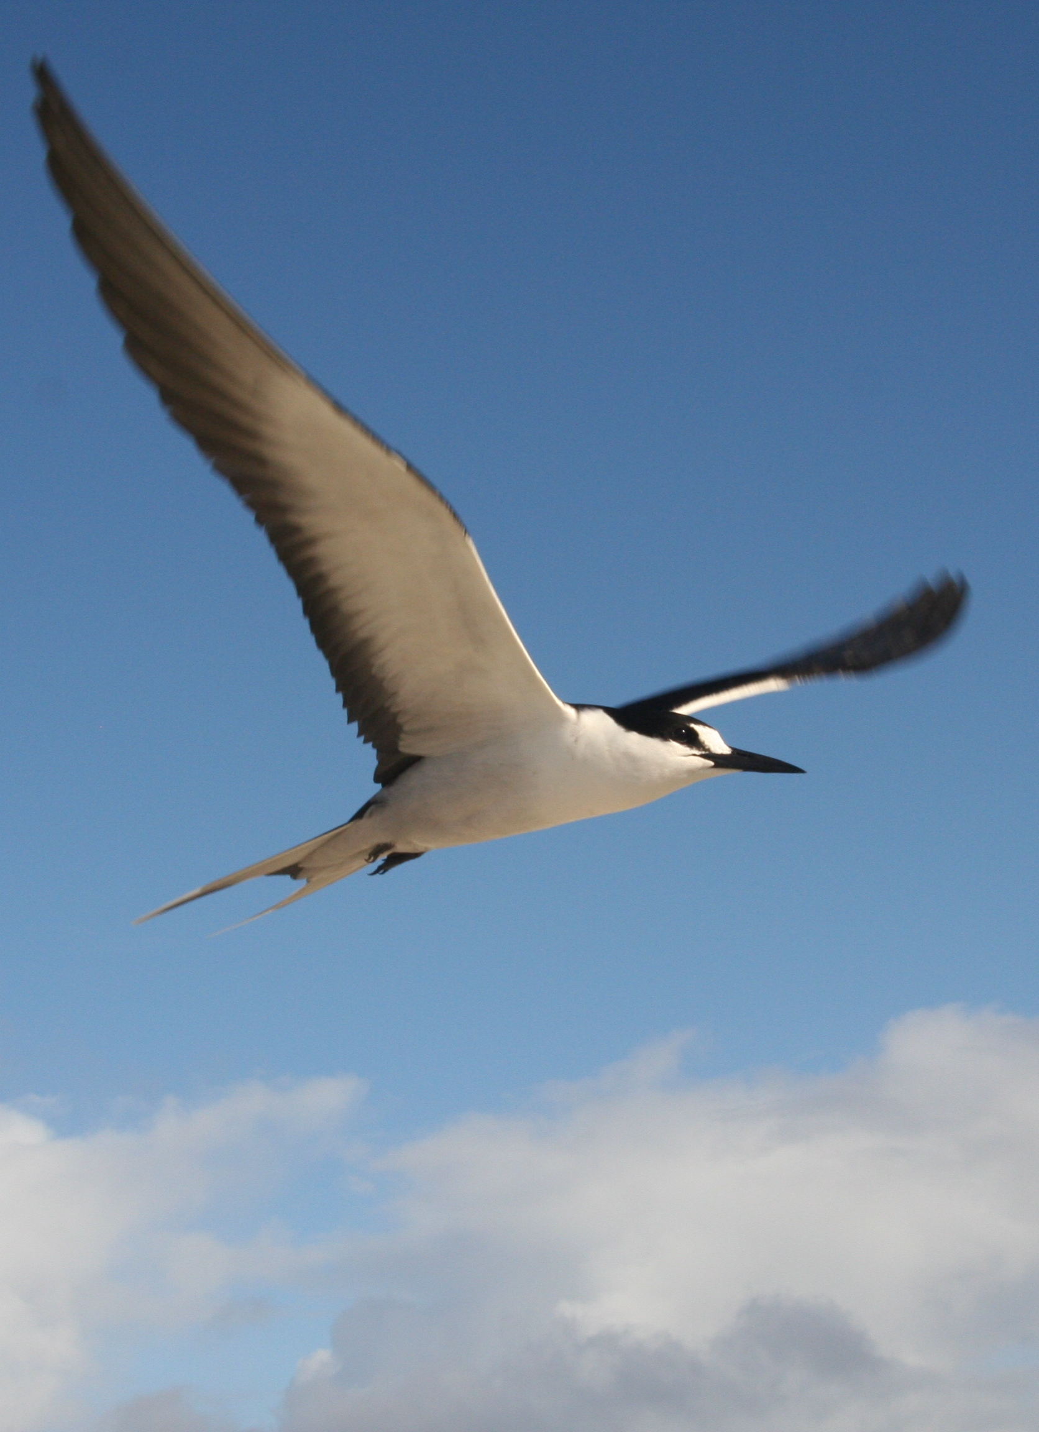
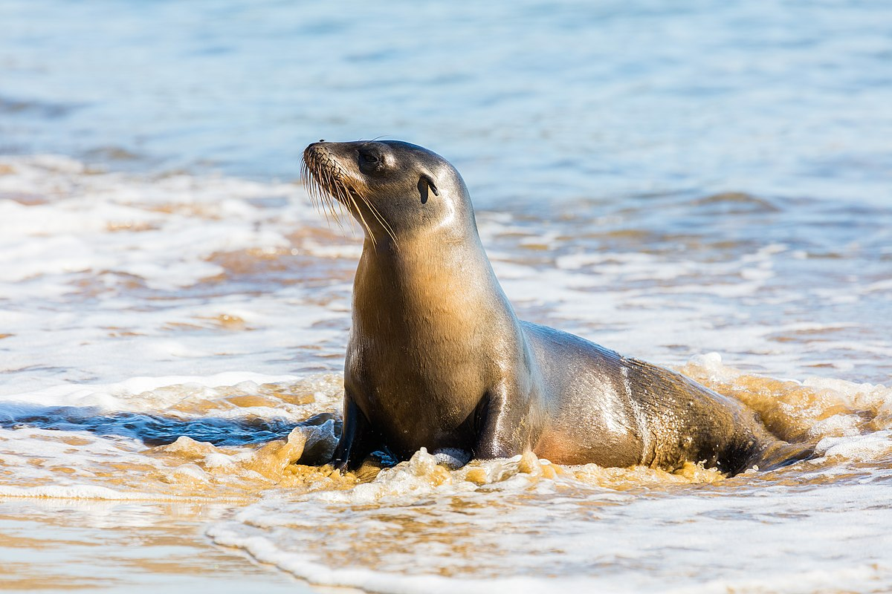
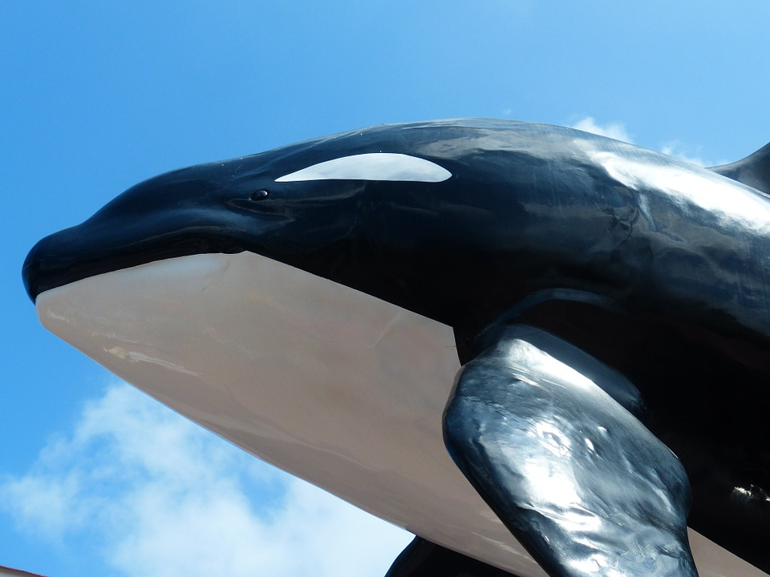

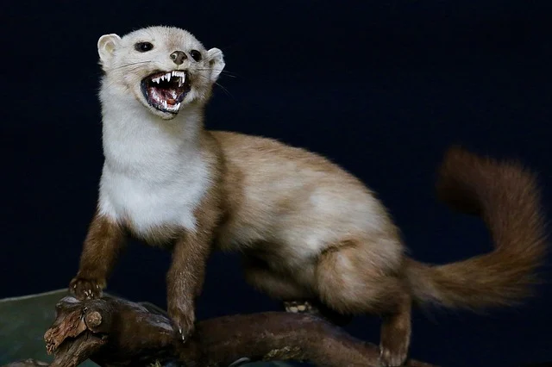
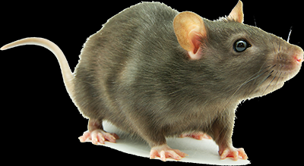

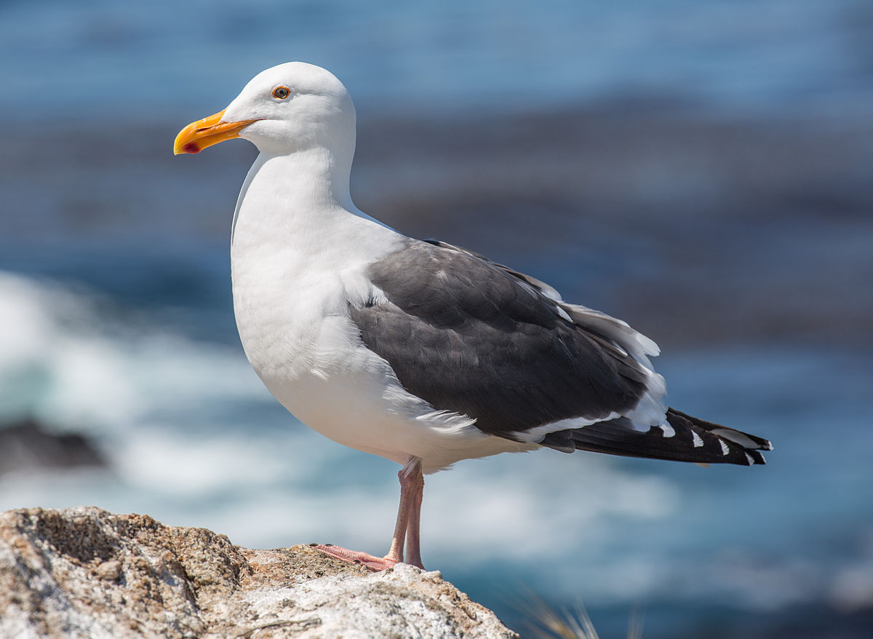
Predators?
Penguins have plenty of predators to watch out for. Sea lions, leopard seals, and orca whales all hunt and eat adult penguins. Seagulls, other sea birds, dogs, cats, weasels, and rats all hunt and eat penguin chicks.

Slide 6
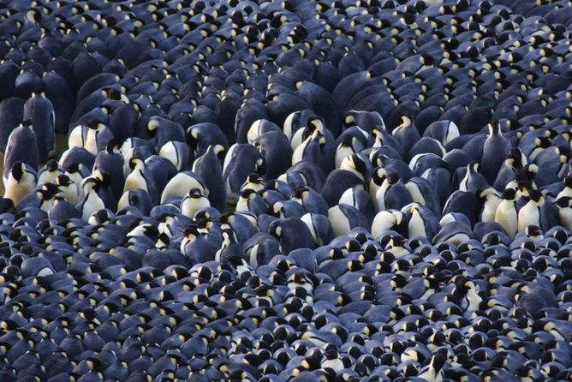
How Do Penguins Stay Warm?
When the temperature is 68F, it helps to stick together. Male emperor penguins huddle to help conserve heat. Of course, some penguins have to stand on the outside of the huddle. So how do they stay warm? They rotate.

Slide 7
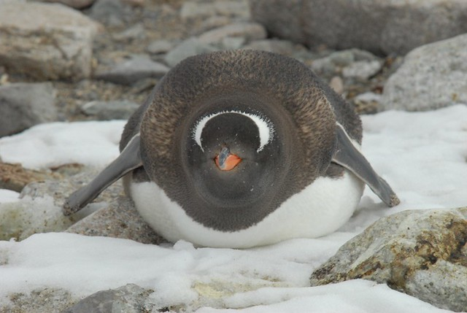
Blubber?
Emperor penguins also have a layer of fat called blubber. The blubber provides energy for the penguins when they can not eat.

Slide 8
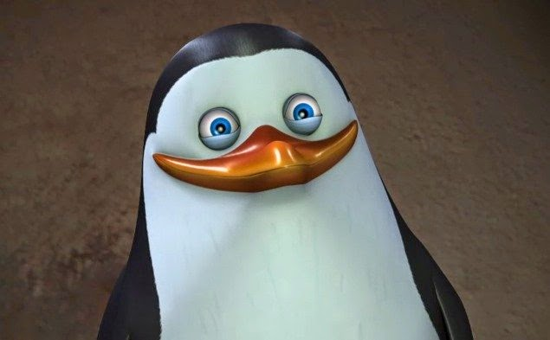
Down?
The outer part blocks the wind and water. The inner fluffy part is called down. The down traps air close to the penguin, keeping the penguin warm.

Slide 9
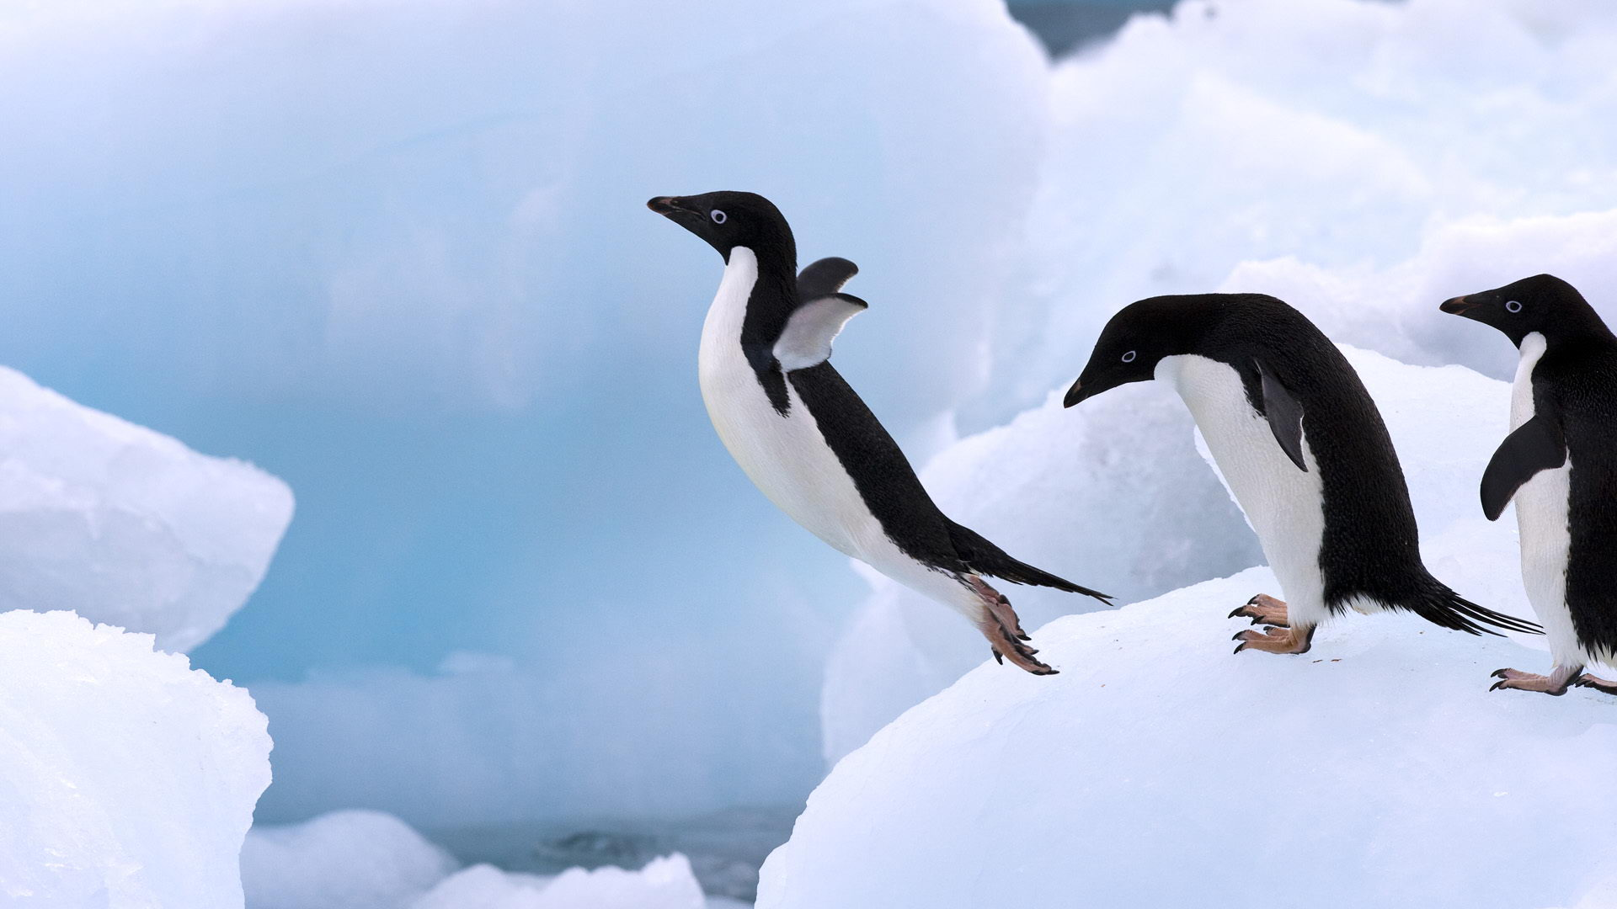
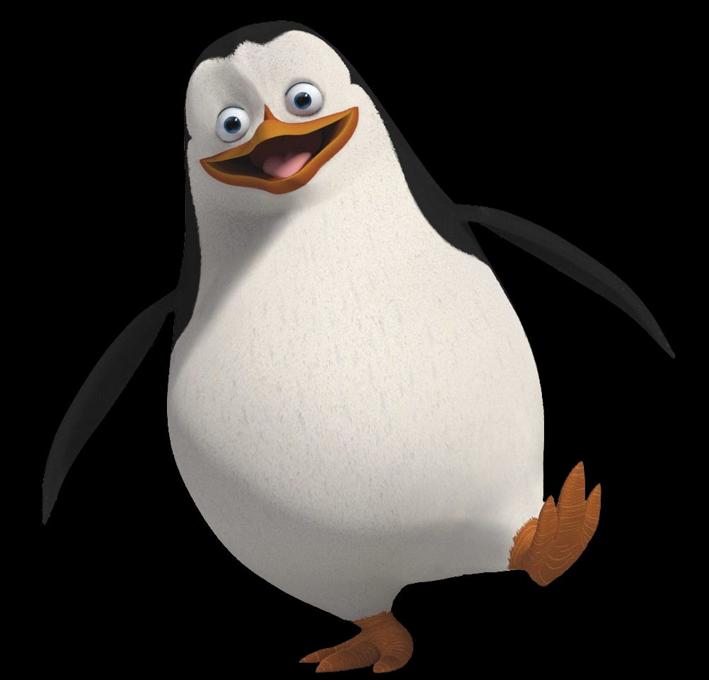
Types Of Penguins

Slide 10
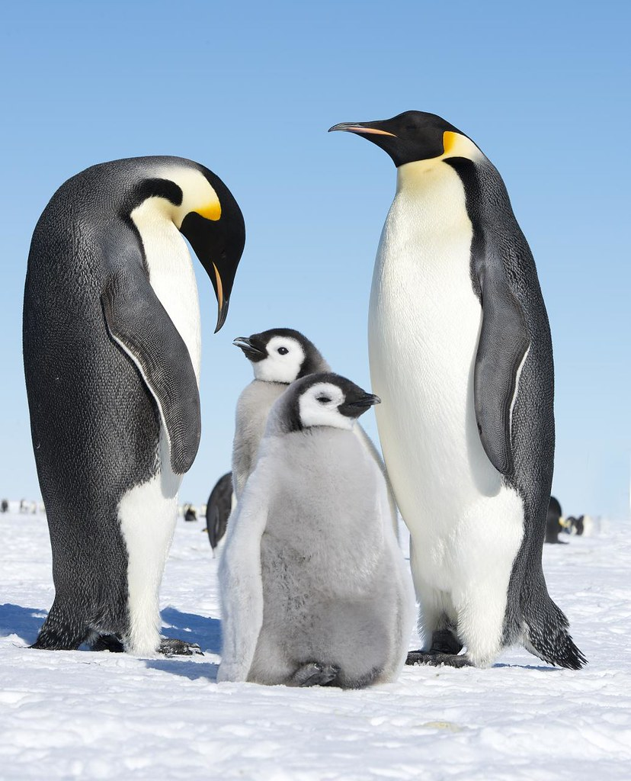
The Emperor Penguin
Emperor penguins stand about three feet tall, making them the largest penguins.
The female emperor penguin lays a single egg. As soon as the egg is laid, the female passes it to her mate.
The male warms the egg in its brood patch.

Slide 11
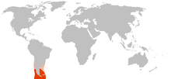
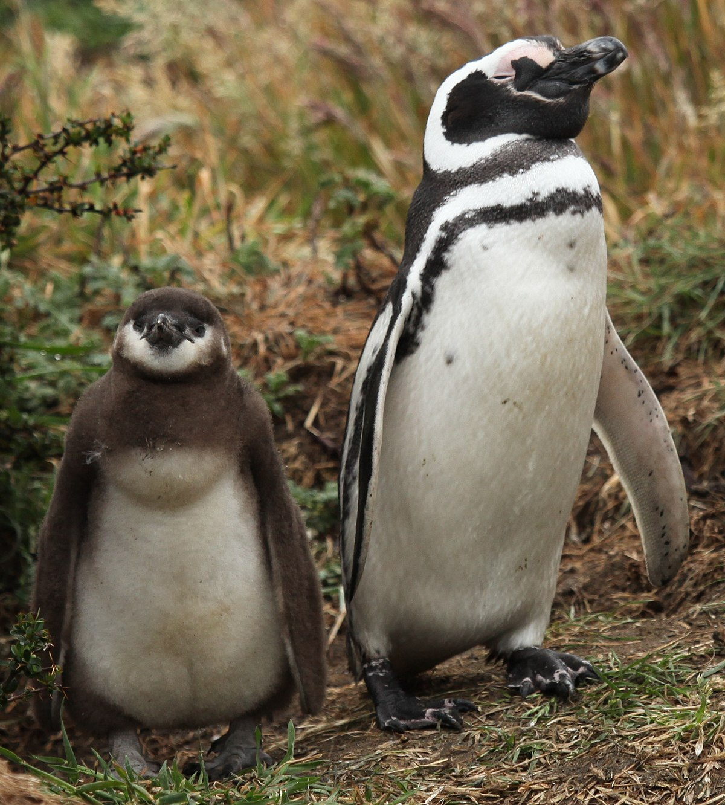
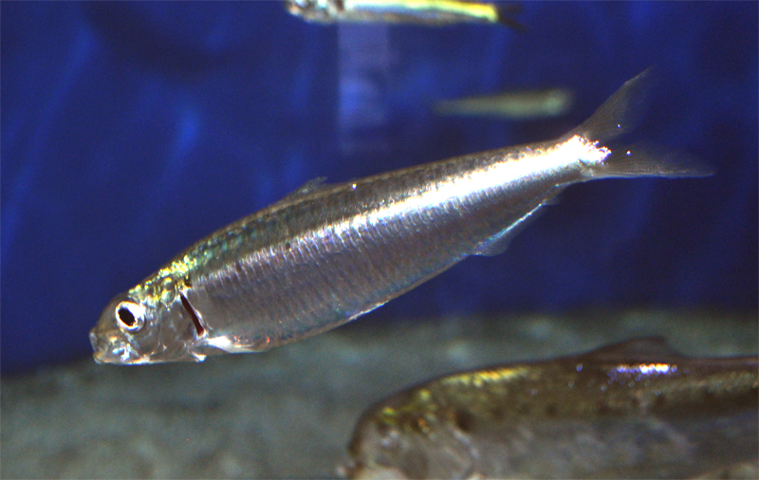
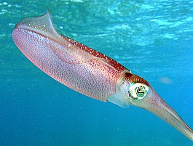

The Magellanic Penguin
Magellanic penguins live on the southern tip of South America and the islands around Antarctica
They build nests in small burrows and under bushes.
Megellanic penguins feed mostly on squid, anchovies, and sardines.

Slide 12
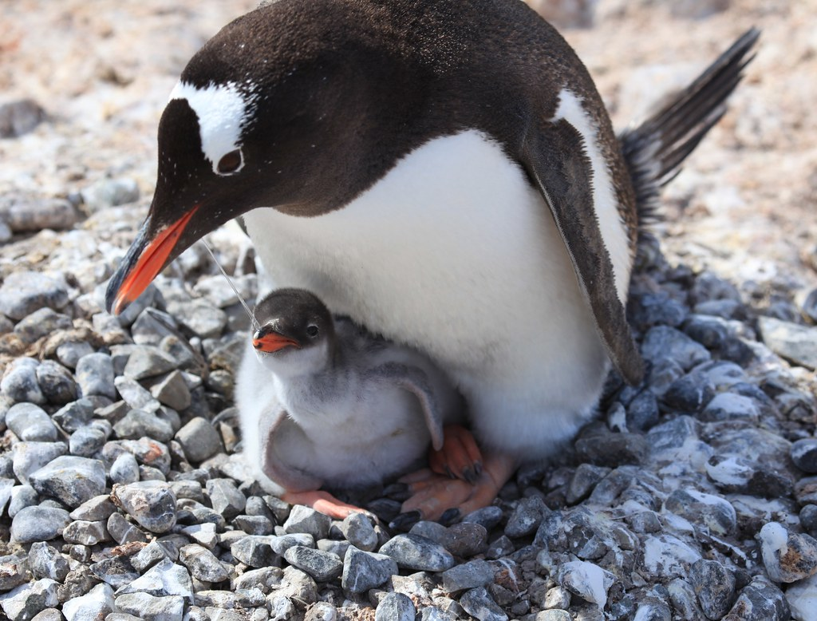
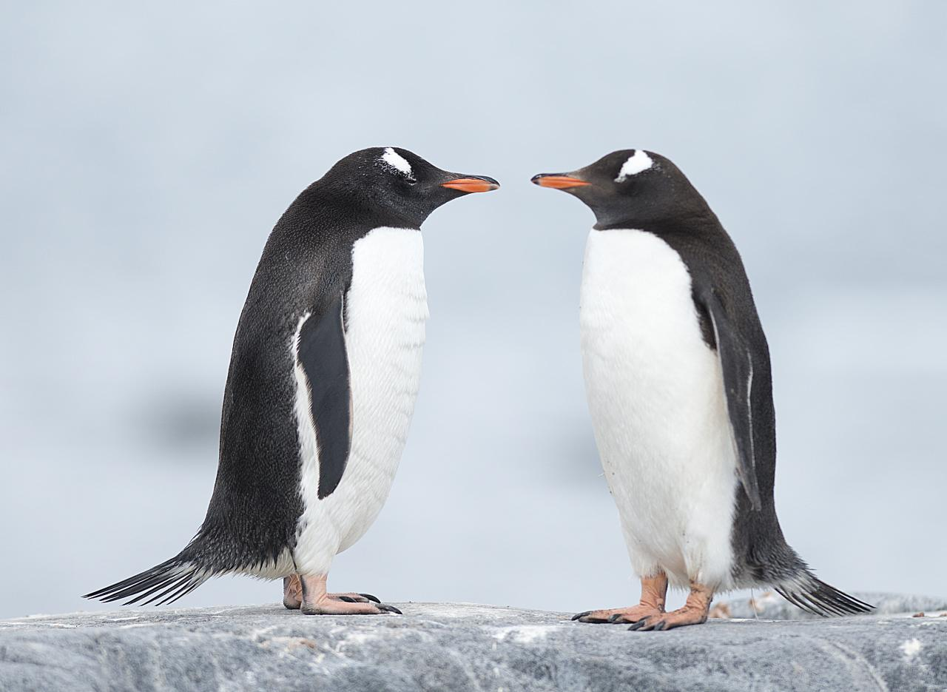
The Adelie Penguin
Adelie penguins grow to about two feet in height.
They build their nests out of pebbles, and lay two eggs.
Both parents take turns keeping the eggs warm and feeding the chicks when they are hatched.
This Photo by Unknown Author is licensed under CC BY-SA

Slide 13
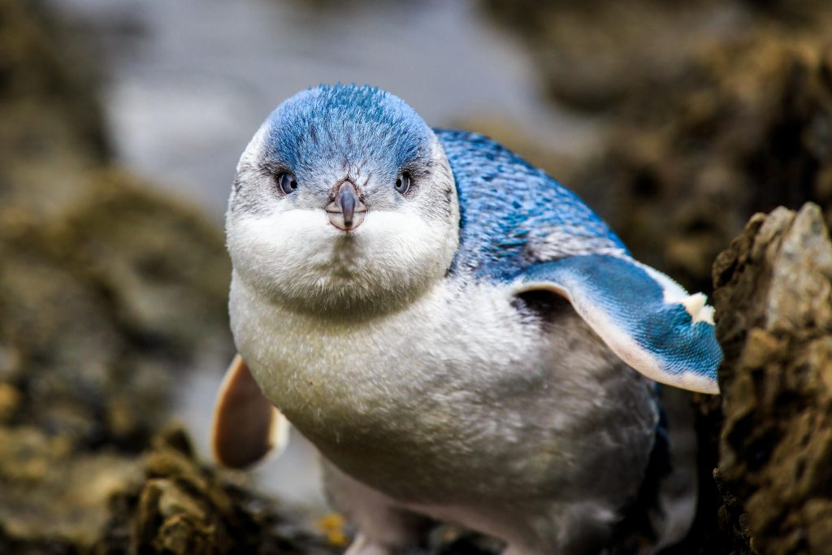
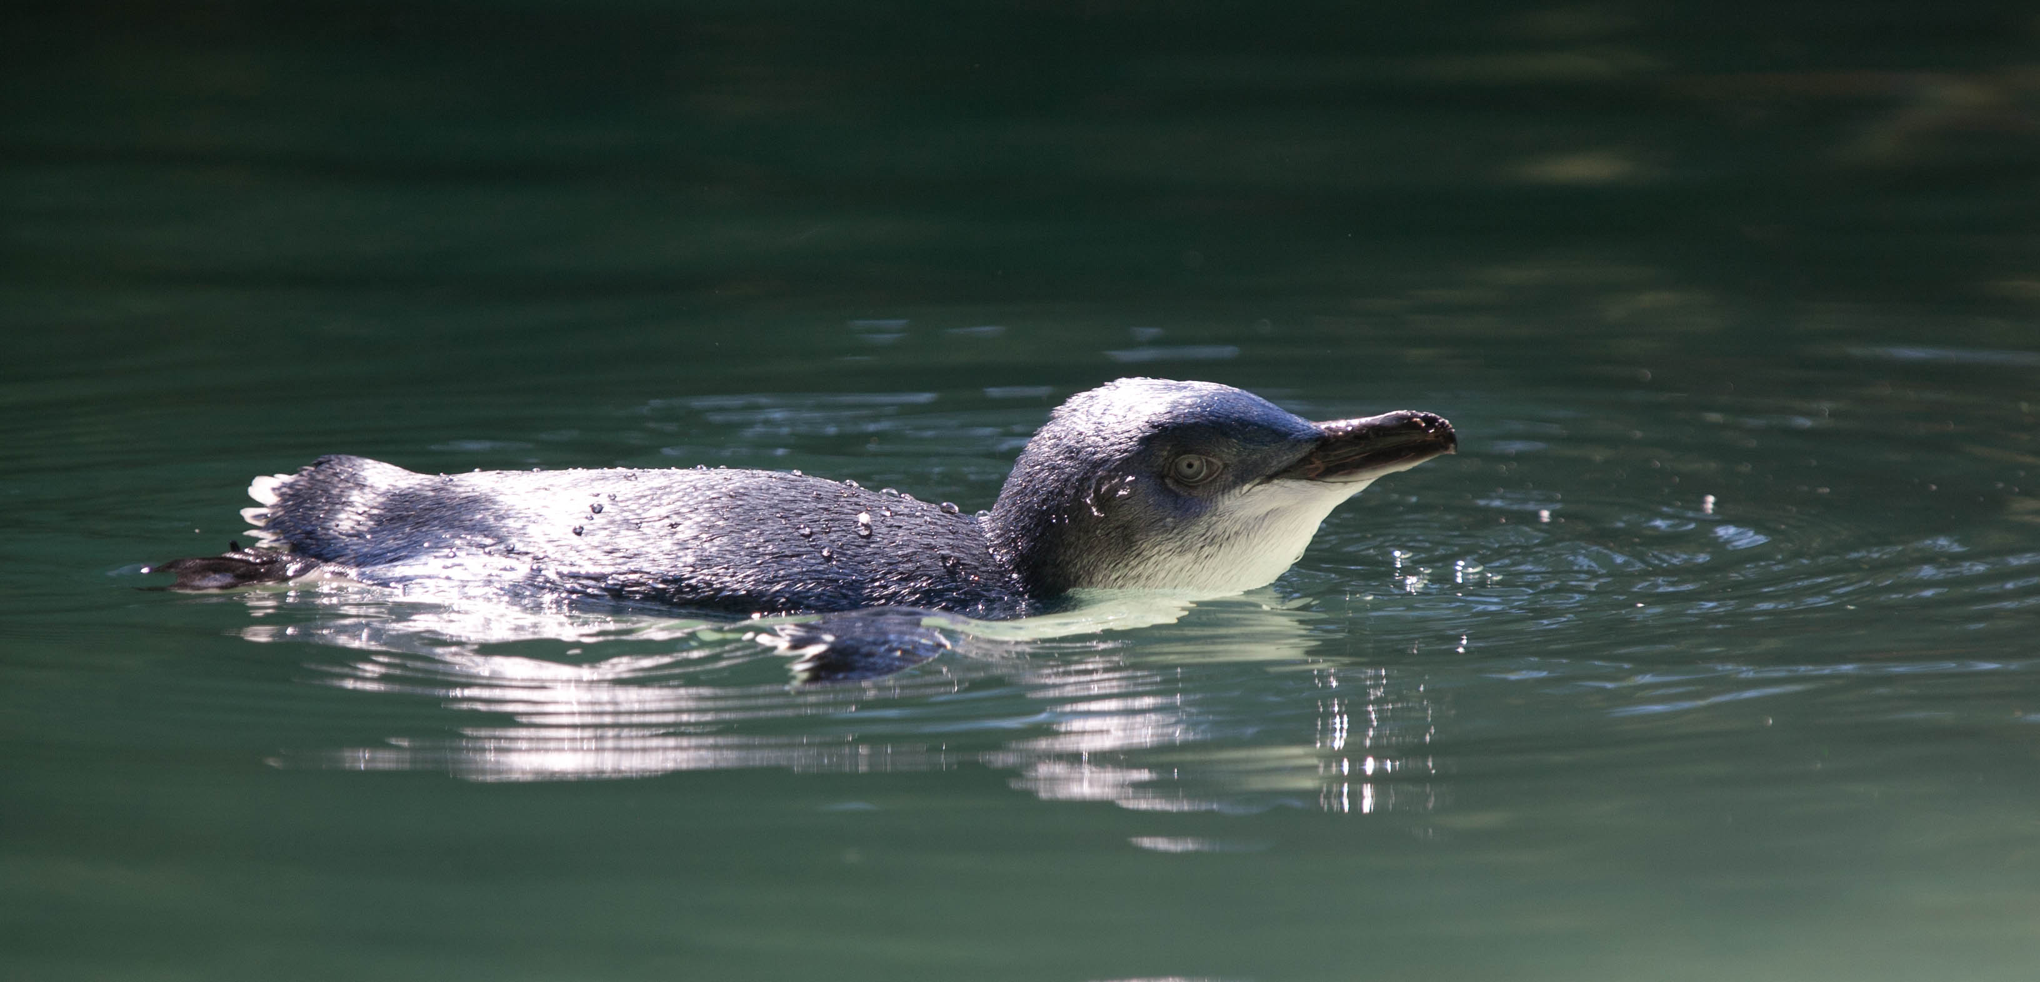
The Little Blue Penguin
The smallest penguin in the world is the Little Blue penguin.
The Little Blue is only one foot tall.
It nests along the southern coasts of Australia, New Zealand, and on the Australian islands of Tasmania.

Slide 14
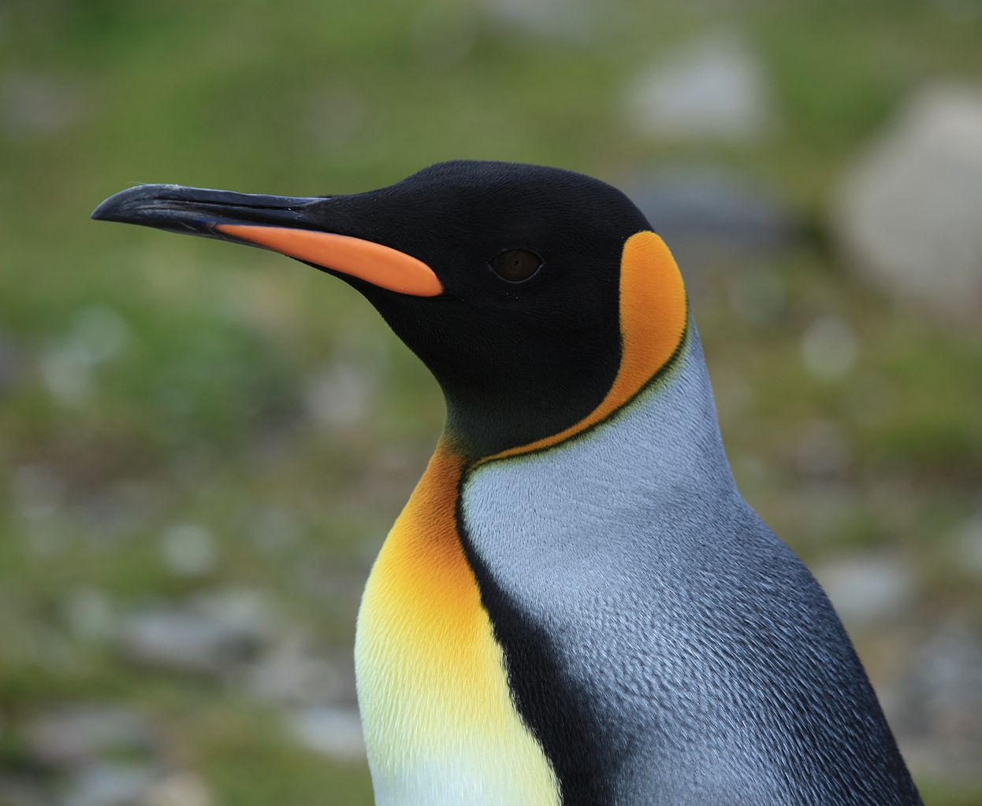
The King Penguin
The King penguin is the second largest penguin.
The Kings has patches of orange feathers near its ears.
The Kings raise their young during the summer on the islands surrounding Antarctica.

Slide 15
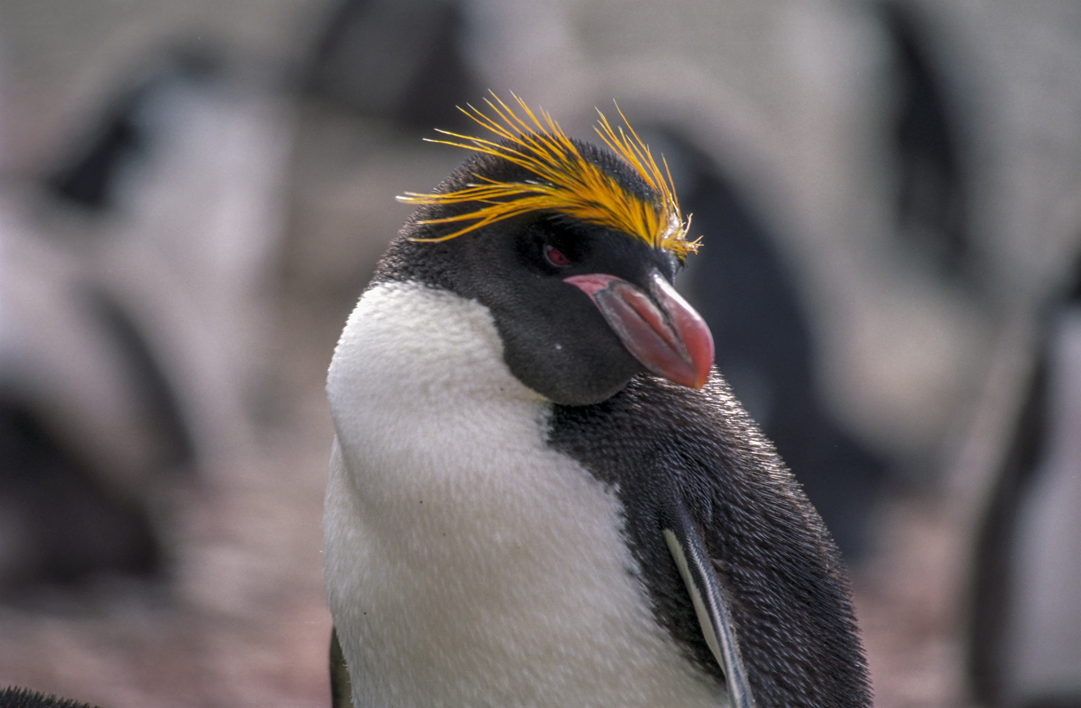
The Crested Penguin
There are six different species of Crested penguins.
Crested penguins live on the islands south of South America, Africa, Australia, and New Zealand.
Crested penguins vary in a size from one to two feet tall.

Slide 16
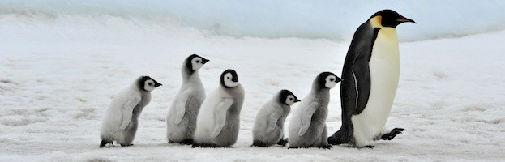
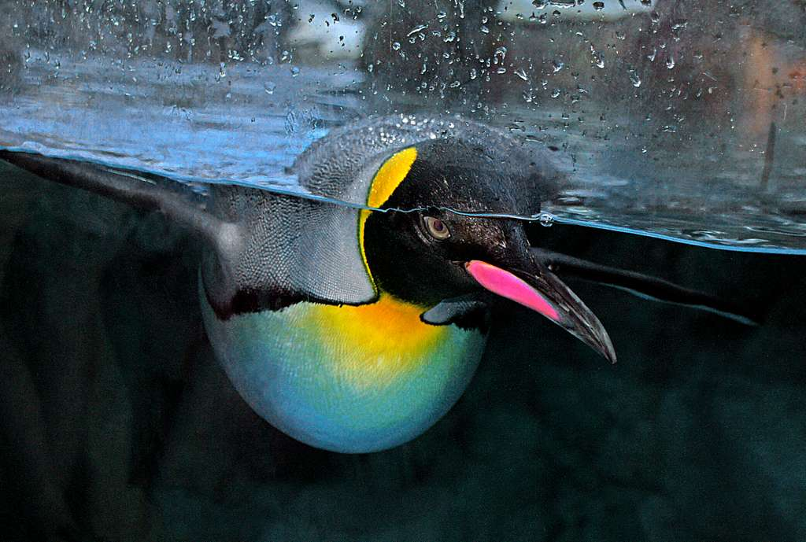
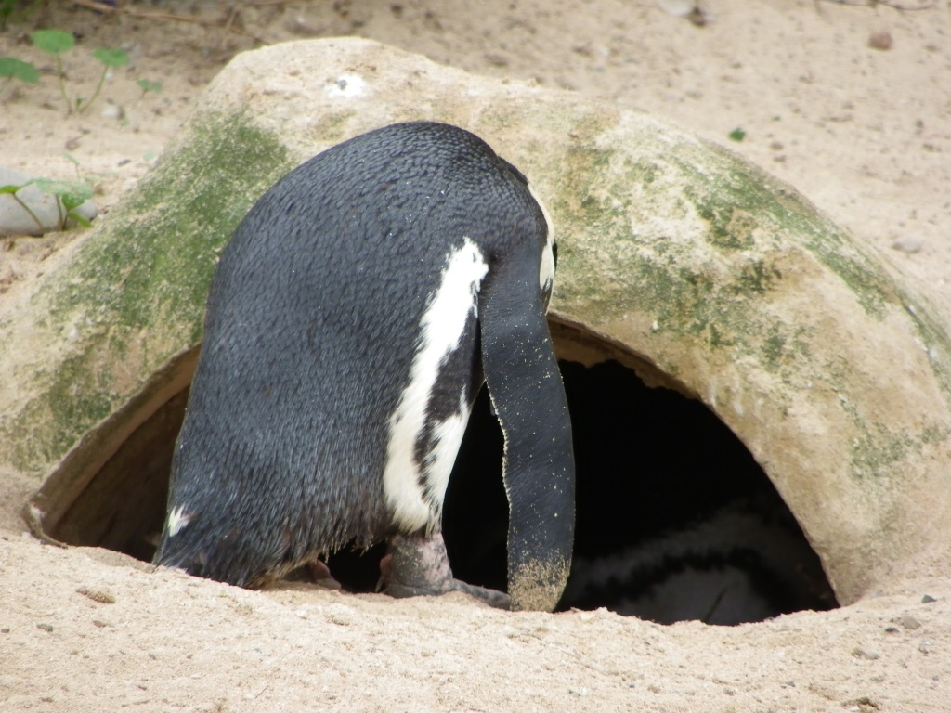
The END

